Slide 1
Fast Food Group Presentation
Edward C. Champion
Matt Todd
Colton Carter

Slide 2
What we hoped to accomplish
Have an interface that can be used to access our database for a fast food company
Be able to log in to affect tables that a regular user would not be able to

Slide 3
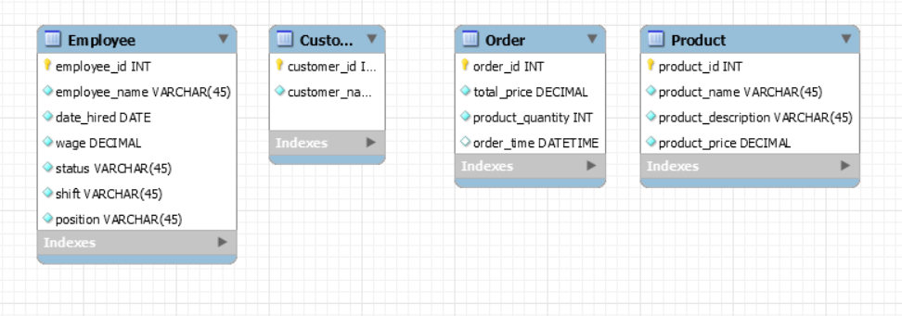
Our Normalization Process - 1NF

Slide 4
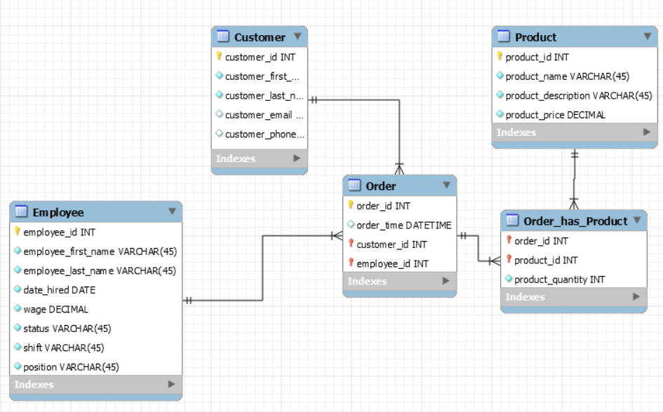
Our Normalization Process - 2NF

Slide 5
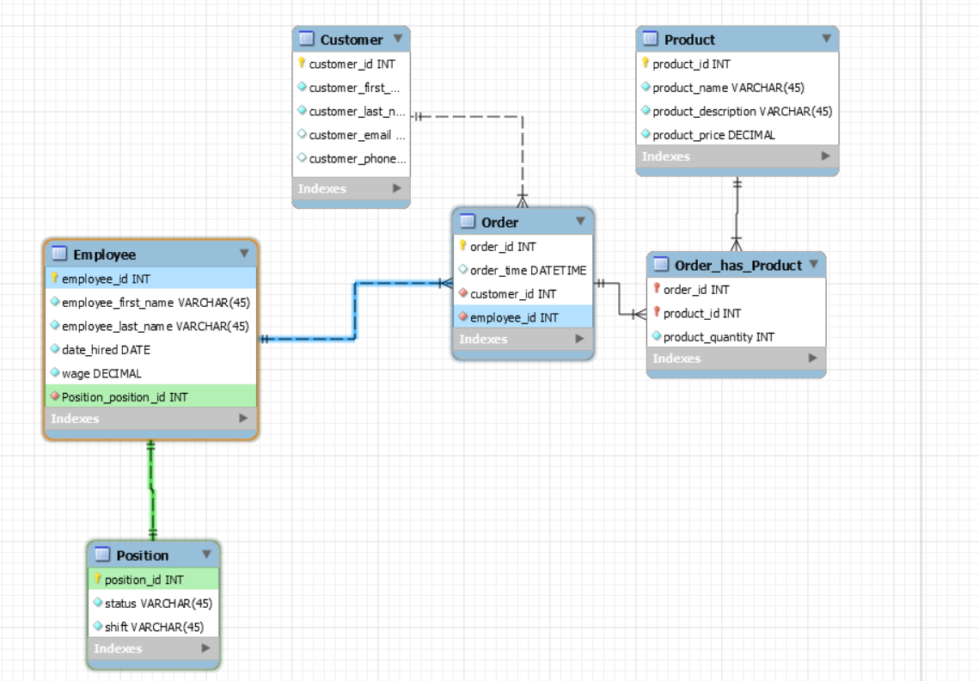
Our Normalization Process - 3NF

Slide 6
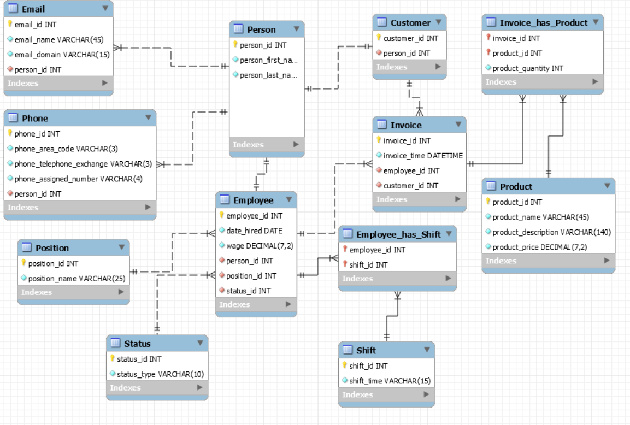
Current ERD - BCNF

Slide 7
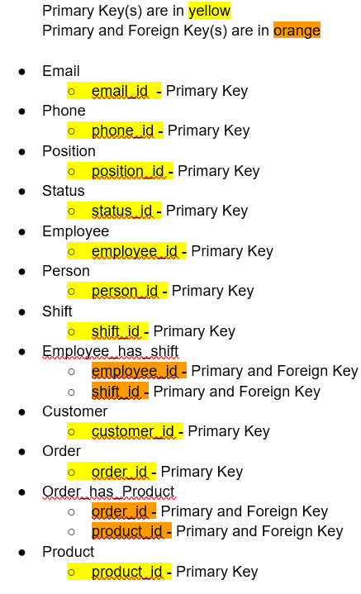
Primary Keys

Slide 8
Foreign Keys
person_id - Foreign Key employee_id - Foreign Key
person_id - Foreign Key customer_id - Foreign Key
person_id - Foreign Key
position_id - Foreign Key
status_id - Foreign Key
person_id - Foreign Key

Slide 9
Triggers
If the position_id is changed, they will receive a wage increase of 25%
We never want a person_id to change, they should always be associated with the same customer_id to avoid duplicates.
We want ensure that everything in Invoice is factual. Therefore if order_time is changed, change it back to it’s original.
We want ensure that everything in Invoice is factual. Therefore if employee_id is changed, change it back to it’s original
We want ensure that everything in Invoice is factual. Therefore if customer_id is changed, change it back to it’s original
If product quantity is updated to 0 or below, order 10 new products automatically.
If product name is updated, change it back to the original name. We do not want to allow name changes, add a new product instead

Slide 10
Demo Time!!!!

Slide 11


Problems that We Had
Pluralization done by Rails
Migrating the data itself from original database
Writing of Scaffolding
Creating the relationships
Authentication and routing

Slide 12
Questions?

